Slide 1

Time Series Model
David Hebert & Ethan Dark

Slide 2
Agenda
Introduction to Time Series Modeling
Project Objective
Modeling
Model Selection
Future Comparison
Final Thoughts

Slide 3
Time Series Modeling
Forecasting
Irregularity and events
Trend Modeling
General analysis approach
ADF, ACF, PACF, ARIMA
Notes:
Understand the search interest for Hulu over a time horizon using Google trends data
Well be utilizing two time series models, a FBProphet model and a Sarimax model for our analysis
Make the data stationary to model for seasonality -> ADF test -> make transformations

Slide 4
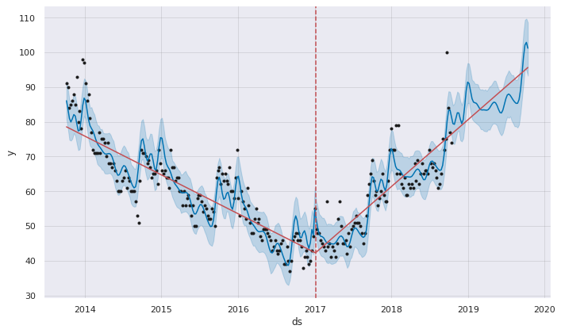
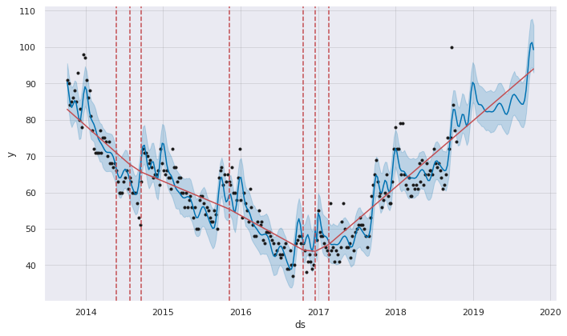
FB Prophet Forecast
Notes:
Changepoints:
June 16, 2016 deal with Disney-ABC for exclusive SVOD rights to past seasons of Disney, Disney Junior, and Disney XD, as well as 20 Disney original movies
January 4, 2017 live broadcasts of CBS and several other channels for the launch of Hulu live streaming along with more shows on-demand
April 11, 2018 Hulu Spotify partnership to bundle at a discount, even cheaper for university students
July 12, 2015 No ad announcement
September 2, 2015 no ad rollout
May 3, 2017 Hulu with Live TV

Slide 5
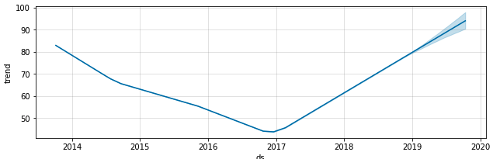
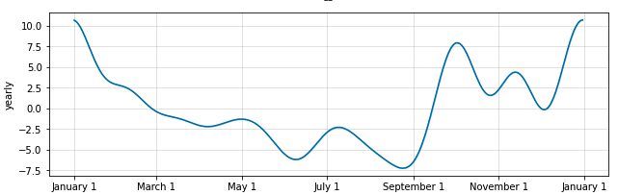
FB Prophet

Slide 6
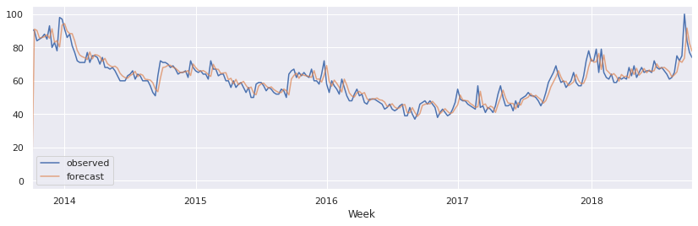
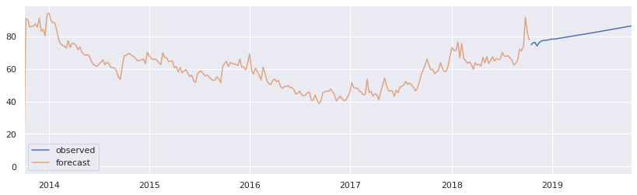
SARIMA Model
Notes:
Here we modeled a SARIMA model, accounting for seasonality
Metric we use to compare models is AIC. AIC=1560
-Graph shows our residuals plotted out,
- upper left looks ok, floating around 0
-Graph on the top right looks good, evenly distributed
A little better than the SARIMAX with distribution

Slide 7
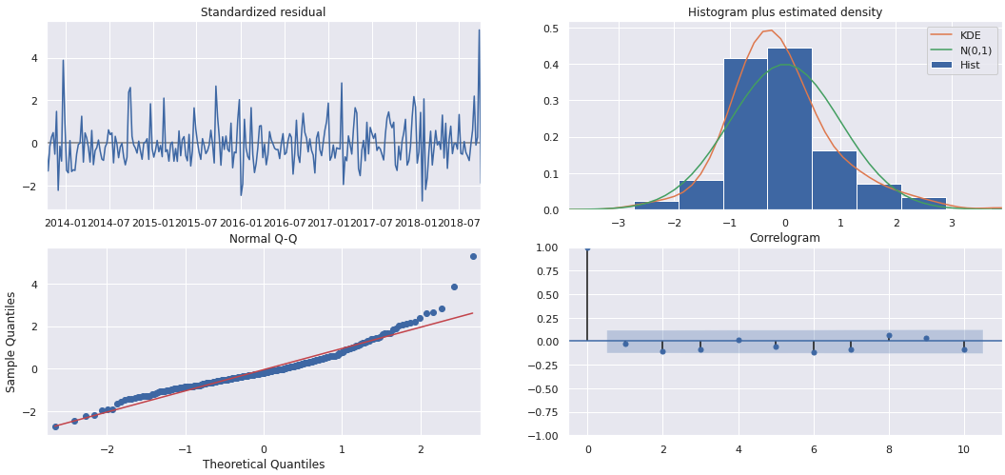
SARIMAX Modeling
Notes:
SARIMAX MODEL (Probably not gonna go with this one)
-Compared to the last model, we are adding a predictor variable, in this case Ad-Spend
-We want to see if ad spend is able to predict google trends
-Graph shows our residuals plotted out,
- upper left looks ok, floating around 0
-Graph on the top right looks good, fairly evenly distributed
-So far the SARIMAX model performs the best according to the AIC. SARIMAX model had a AIC of 1555 whereas our ARIMA model had an AIC of 1561 and our previous SARIMA model had an AIC of 1560.
-Although our SARIMAX model has the best AIC, the p-value (.59) indicates that ad spend does not predict google trends.
-So with model selection, we would probably want to choose the model with the next lowest AIC value.
-Even if it the total- ad spend was significant, the AIC does not deviate from the previous models much so we would want to inspect the effect/magnitude of the coefficient of an extra google ad point to see if it would be worthy.

Slide 8
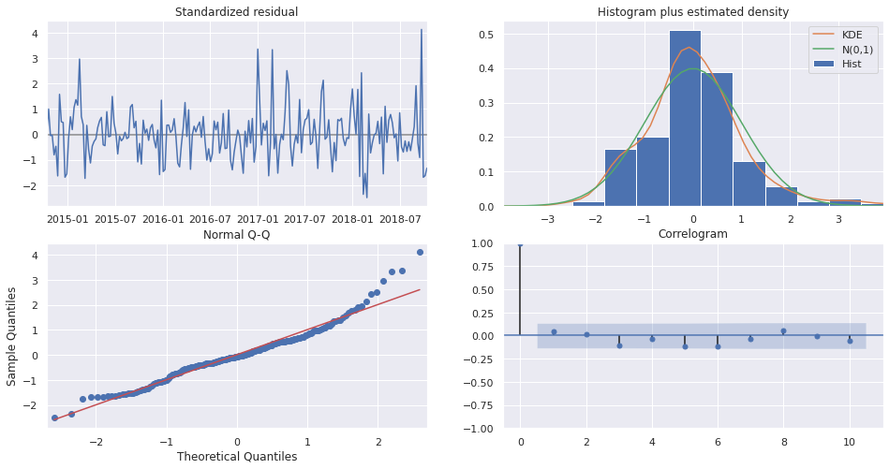
Pyramid ARIMA Optimization
Notes:
Finally used auto arima to find the model with the best parameters
This process programmatically iterates thru different variations of the model so we can quickly find the best one
Stepwise model -> AIC = 1250

Slide 9
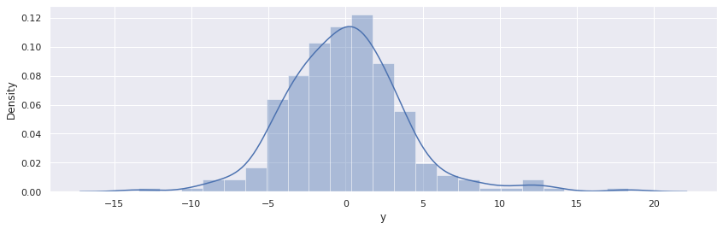
Lasso with Time Control

Slide 10

Model Selection
Sarimax Model
MSE: 14.77
RMSE: 3.84
MAE: 2.82
Facebook Prophet Model
MSE: 63.28
RMSE: 7.95
MAE: 4.05

Slide 11
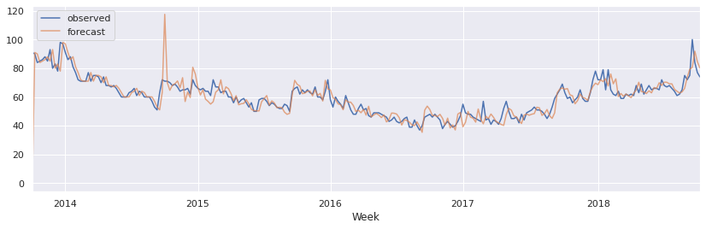
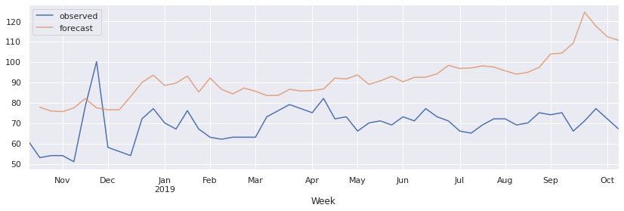
Future Comparison
Notes:
The Mean Squared Error of our forecasts is 628.62
The Root Mean Squared Error of our forecasts is 25.07
The Mean Absolute Error of our forecasts is 23.1

Slide 12
Final Thoughts
Unexpected outperformance
Seasonality versus advertising
Applying lasso to Sarimax model
Predictive accuracy
Notes:
Deploy the auto-arima model since it has the lowest AIC
SARIMAX model looked good when the residuals were graphed out, but results suggests that ad spend does not predict google trends.
This make sense since there aren't that many ads for Hulu compared to many other companies out there and because Hulu is a service
When you look at a company like Apple, you may see many offers and ads around holidays and certain times of the year which most likely drives a lot of search
For hulu, most of the search is driven by their offerings/ limited time offerings with pricing/bundles and any add ons with shows (based on the historical trends as mentioned by Ethan in the beginning)

